Slide 1

CMP201 – Data Structures and Algorithms 1 Coursework
Joseph lee – 1903399

Slide 2
Comparison Between Lee and A* Pathfinding Algorithms For Pathfinding With Seabed Bathymetry Data

Slide 3
Problem

Slide 4
The Real-world Problem
In the offshore tidal energy industry there is often a requirement to route subsea cables on the seabed. These routes need to factor in both the distance of a cable run and smoothness of the seabed for this run as the cables experience excess fatigue and movement on the seabed if they have any unsupported spans.
This project set out to implement a method to calculate these routes between a selected start point and endpoint.

Slide 5
Bathymetry Data

Slide 6
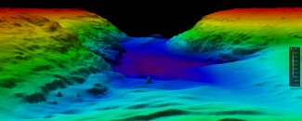
Bathymetry Data
Bathymetry Data is a 3D representation of the seabed gathered from a set of depth and position results. When interpolated and plotted as a contour or surface they give a 3D representation of the seabed.
https://www.ncei.noaa.gov/sites/default/files/styles/max_325x325/public/sites/default/files/bathymetry-image-1200x480.png?itok=82IoqMAs

Slide 7
Bathymetry Data
The data used for this project is a small sample of the bathymetry data for the North Connel River, UK Hydrographic Office Suvery (2014 HI1441 Loch Etive 2m SDTP). https://datahub.admiralty.co.uk/Bathy_Data/Prodbathy/Bathymetry/2014%20HI1441%20Loch%20Etive%202m%20SDTP.bag
Data converted from .bag to .csv using global mapper

Slide 8
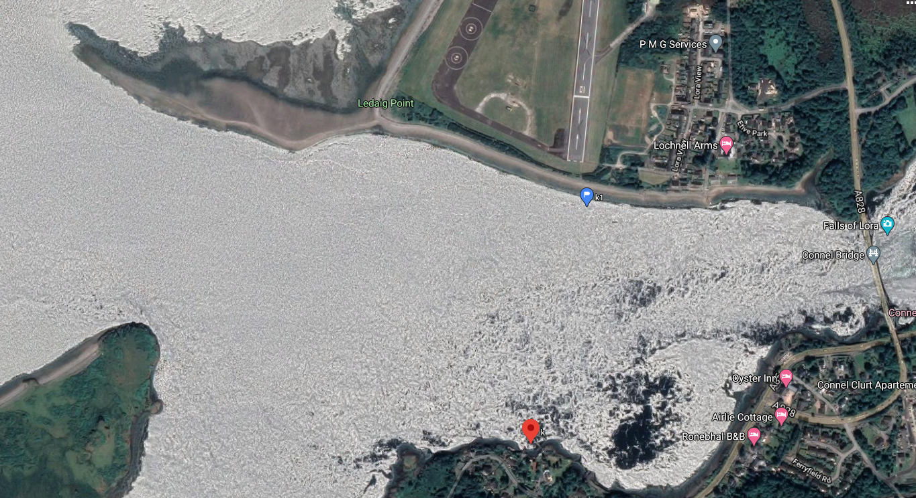
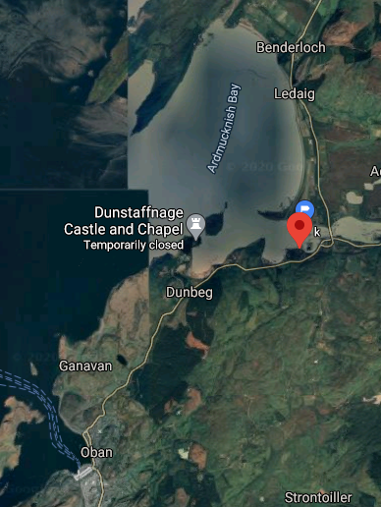
Bathymetry Data
~122m
Approximate
Sample Data
Area
~454m

Slide 9
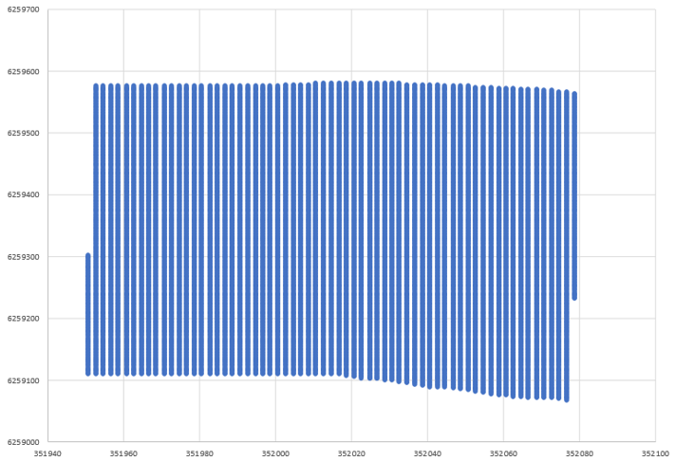
Bathymetry Data
Data is a grid of discrete point in rows and columns as shown below:

Slide 10
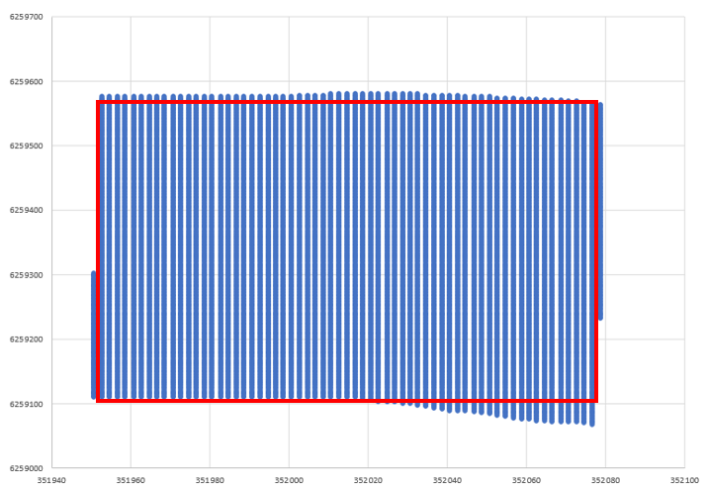
Bathymetry Data
To make the data easier to process in the context the dataset has been trimmed:

Slide 11
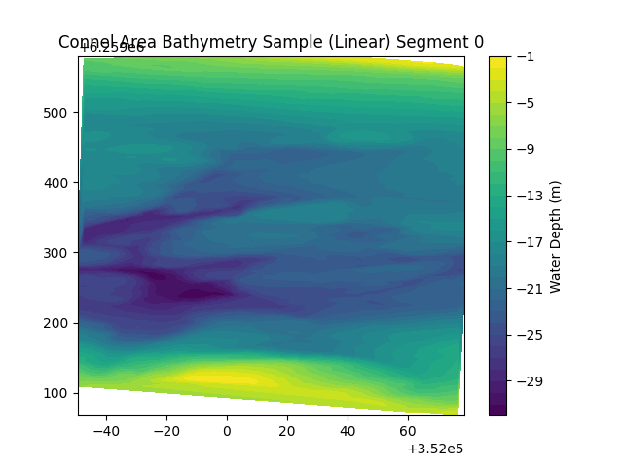
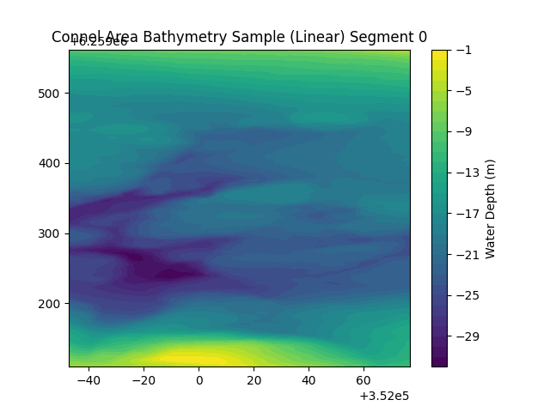
Bathymetry Data
Full Dataset
Trimmed Dataset

Slide 12
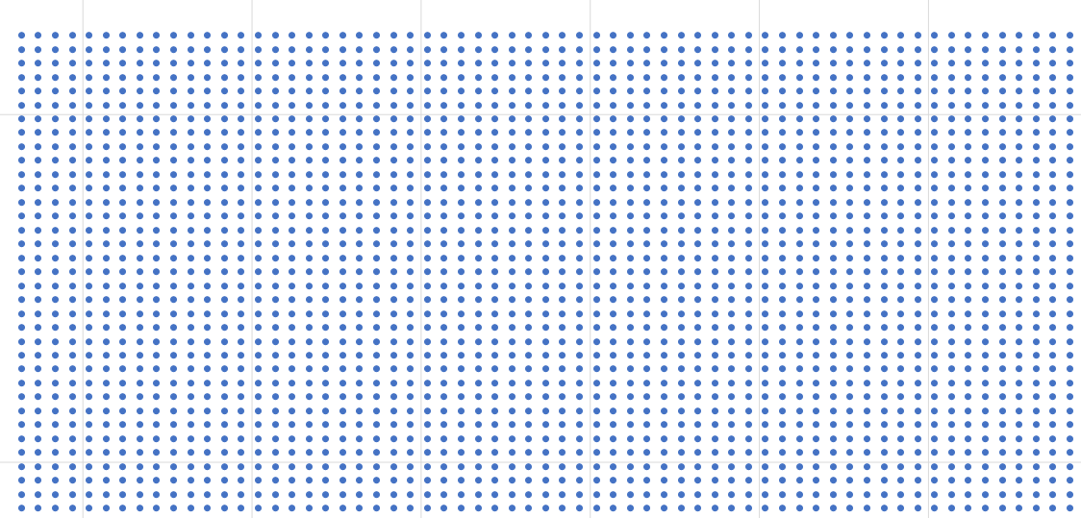
Bathymetry Data
Zoomed data

Slide 13
Representation of Data
As the bathymetry data itself is a grid of discrete points the choice was made to represent the data as a grid for the pathfinding algorithm. As the size of the data grid is not fixed the decision was made to use a 2D vector. std::vector<std::vector<node>>, with the node being the relevant node type for each pathfinding algorithm.
The population of this grid has a time complexity O(N^2) however, this operation only needs to take place one at the start of the pathfinding function and no additional items need to be inserted into the 2D vector at a later stage.
One advantage of this approach is that to access each element for pathfinding has a time complexity of O(1).

Slide 14
Lee Algorithm

Slide 15
LeeNode

Slide 16
Depth Weighting

Slide 17
A* Algorithm

Slide 18
AStarNode
Each AStarNode contains the below data:
G_Cost – Distance from this node to the start node
H_Cost – Estimated distance from this node to the goal
F_Cost – Total Node Cost (G_Cost + H_Cost)
Depth – Depth of node based on bathymetry
Distance – Distance between this node and the previous node
Position – Relative position of node within the AStarGrid
UtmPosition – Real-world UTM position of this node
ParentNode – A pointer to the parent node of this node
Visited – Set to true when a node has been visited and added to the closed set

Slide 19
Heuristic
The heuristic selected for this A* algorithm has was the Manhattan Distance because of this the route movement has been limited to 4 directions (up, down, left, right).
The Manhattan Distance is calculated:
Manhattan Distance = Δx between this node and goal +

Slide 20
Optimizations

Slide 21
Results

Slide 22
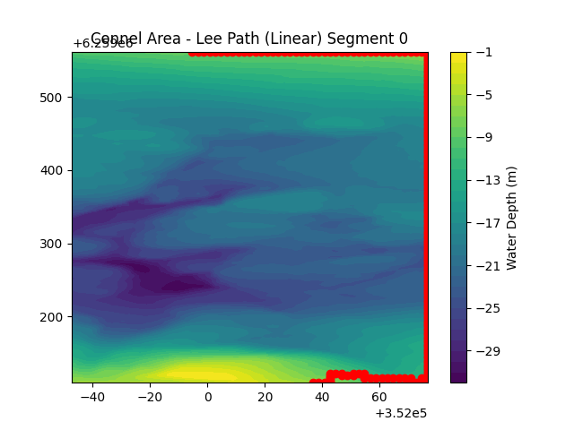
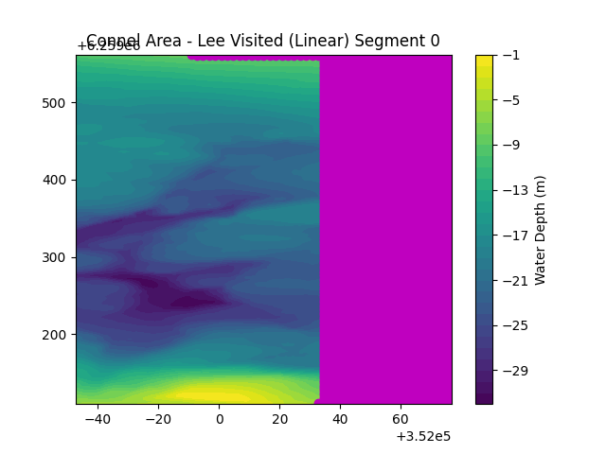
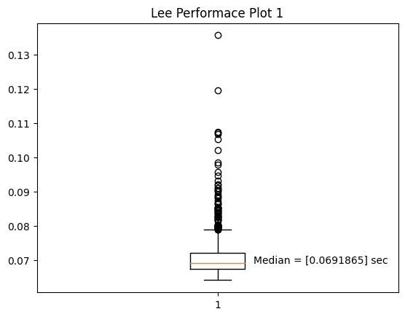
Plot 1 - Lee

Slide 23
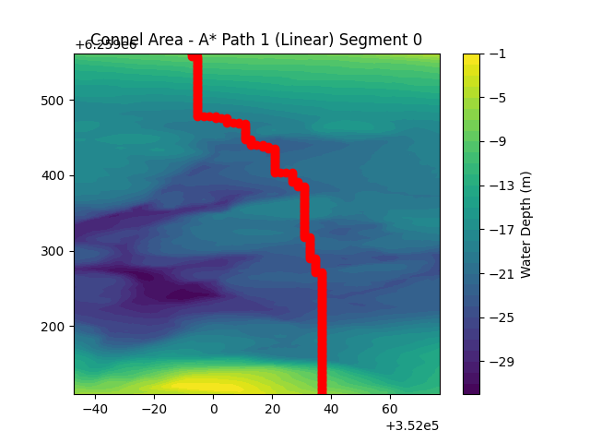
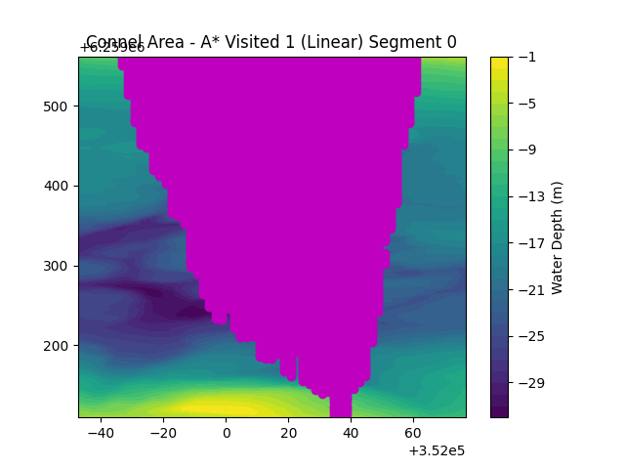
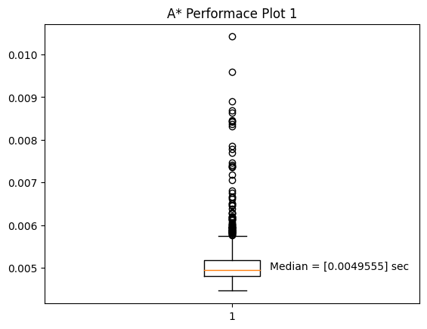
Plot 1 – A*

Slide 24
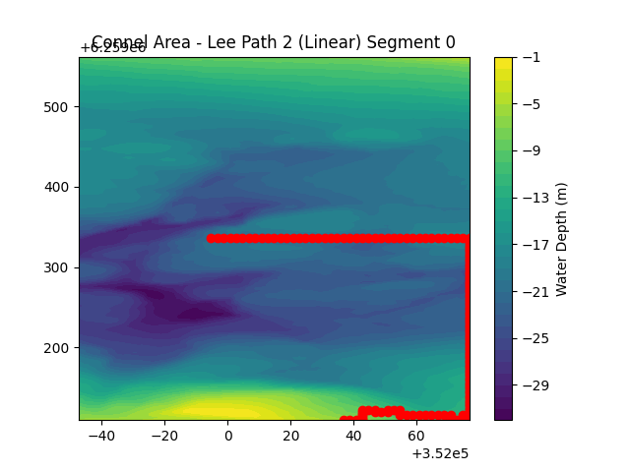
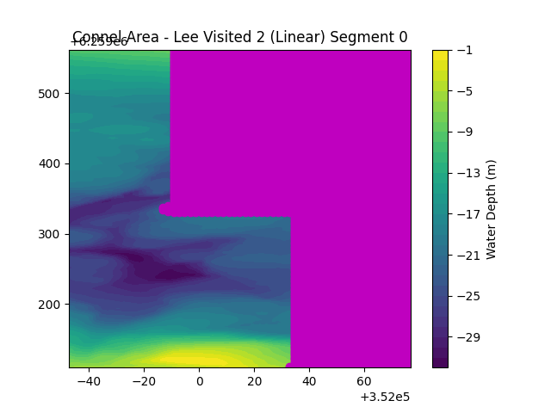
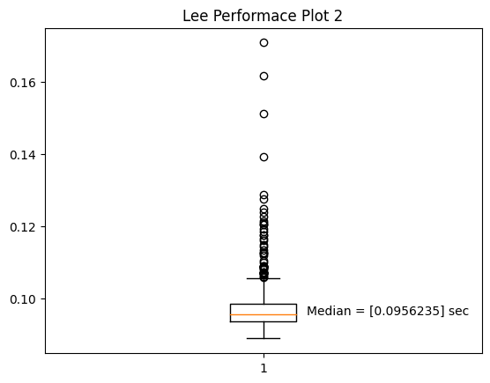
Plot 2 – Lee

Slide 25
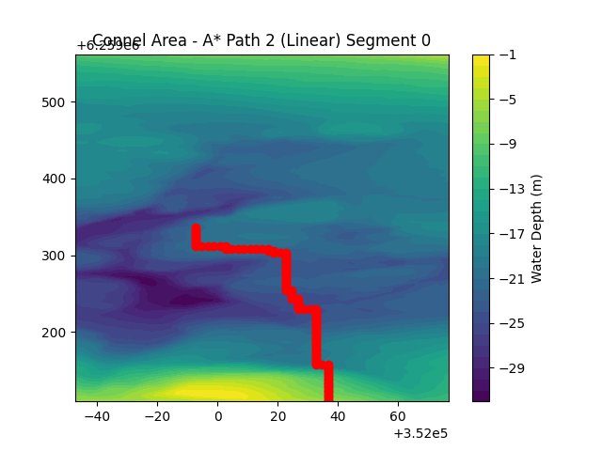
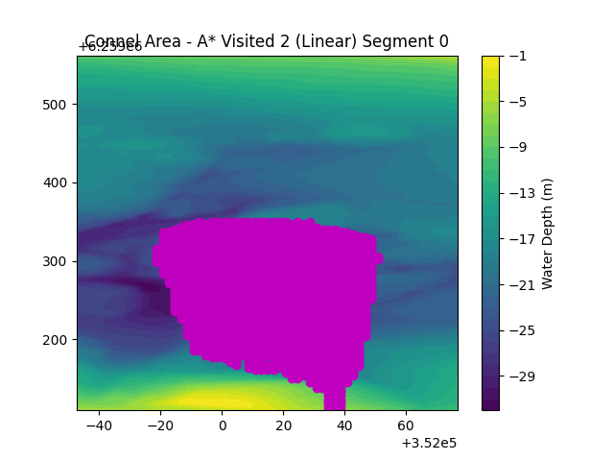
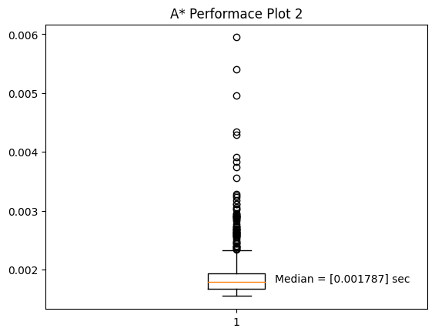
Plot 2 – A*

Slide 26

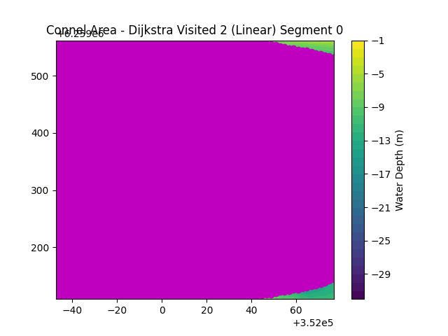
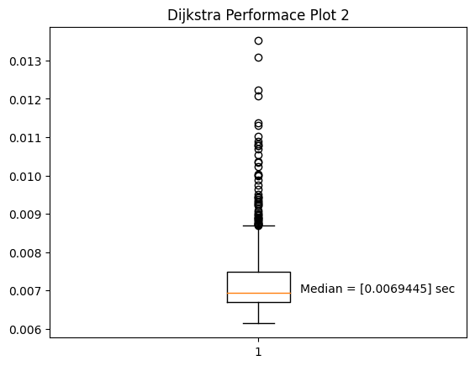
Plot 2 – Dijkstra

Slide 27
Summary
Algorithm | Plot 1 – Median Time (Seconds) | Plot 1 – Percentage Execution Time Increase Over A* | Plot 2 – Median Time (Seconds) | Plot 2 – Percentage Execution Time Increase Over A*
Lee | 0.0691865 | 1296.16% | 0.0956235 | 5251.06%
A* | 0.0049555 |  | 0.0017870
Dijkstra |  |  | 0.0069445 | 288.612%
For both Plot 1 & Plot 2 the A* algorithm was the fastest. The A* algorithm was faster than the Lee algorithm by 0.064231 sec (1296.16% increase over A*) for plot 1 and 0.0938365 sec (5251.06% increase over A*) for Plot 2.
For comparison for Plot 2 the Dijkstra algorithm was included, this was 0.0051575 sec (288.612% increase over A*).

Slide 28
Conclusion

Slide 29
Conclusion

Slide 30
Future Work

Slide 31
Future Work

